Slide 1
UNIT-1
Agile and Scrum Principles

Slide 2
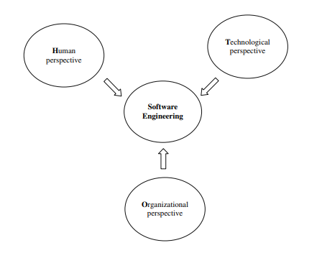
Three Perspectives of software engineering
Human perspective
Organizational perspective
Technological perspective

Slide 3
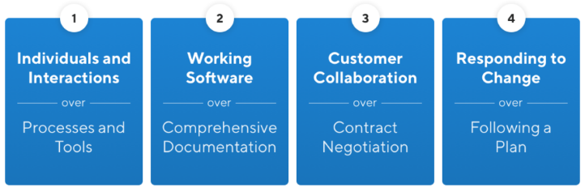
Agile Manifesto
The Agile Manifesto is a document that identifies four key values and 12 principles that its authors believe software developers should use to guide their work.

Slide 4
Agile Principles
Satisfy Customers Through Early & Continuous Delivery
Welcome Changing Requirements Even Late in the Project
Deliver Value Frequently
Business people and developers must work together daily throughout the project
Build Projects Around Motivated Individuals
Communicate Face-to-face
Working Software is the Primary Measure of Progress
Maintain a Sustainable Working Pace
Continuous attention to technical excellence
Simplicity
Self-organizing Teams
At regular intervals, the team reflects on how to become more effective, then tunes and adjusts its behavior accordingly.

Slide 5
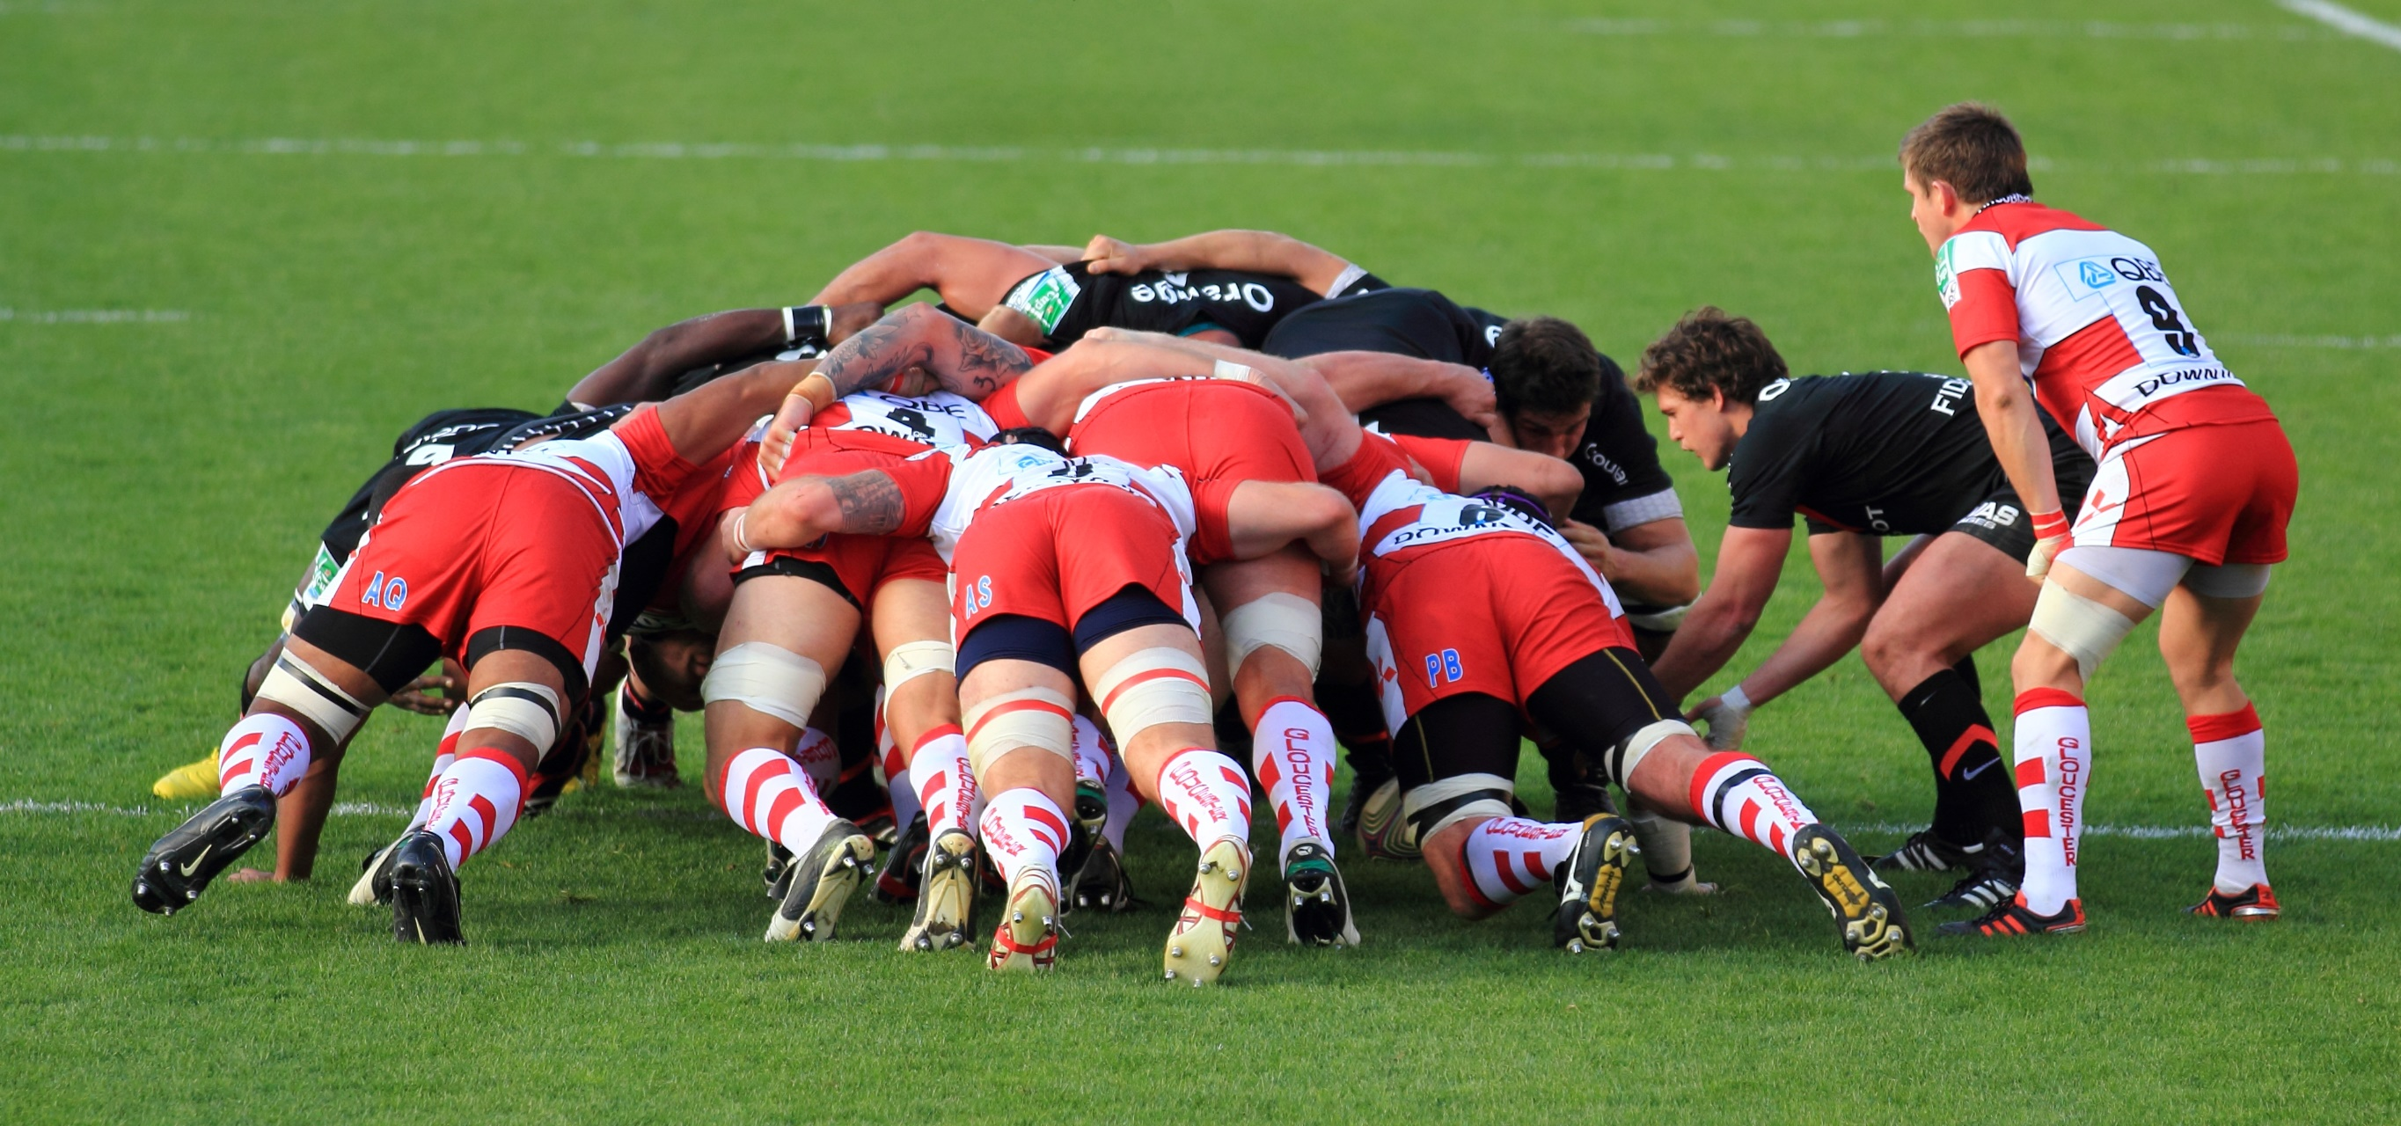
Elaborate your view…..

Slide 6
Scrum
Scrum is a framework that helps teams work together. Much like a rugby team training for the big game, scrum encourages teams to learn through experiences, self-organize while working on a problem, and reflect on their wins and losses to continuously improve.
Scrum Team
A scrum team is a group of collaborators, typically between five and nine individuals, who work toward completing projects and delivering products.
One scrum master,
One product owner and
A group of developers.

Slide 7
Basic Definitions
A Sprint is a short, time-boxed period when a scrum team works to complete a set amount of work.
A Product backlog is a prioritized list of work for the development team that is derived from the roadmap and its requirements. The most important items are shown at the top of the product backlog so the team knows what to deliver first
A Sprint backlog is a subset of the product backlog and lists the work items to complete in one specific sprint. The purpose of the sprint backlog is to identify items from the product backlog that the team will work on during the sprint.

Slide 8
Scrum Events
Sprint Planning
Daily Scrum
Sprint Review
Sprint Retrospective
The Sprint

Slide 9
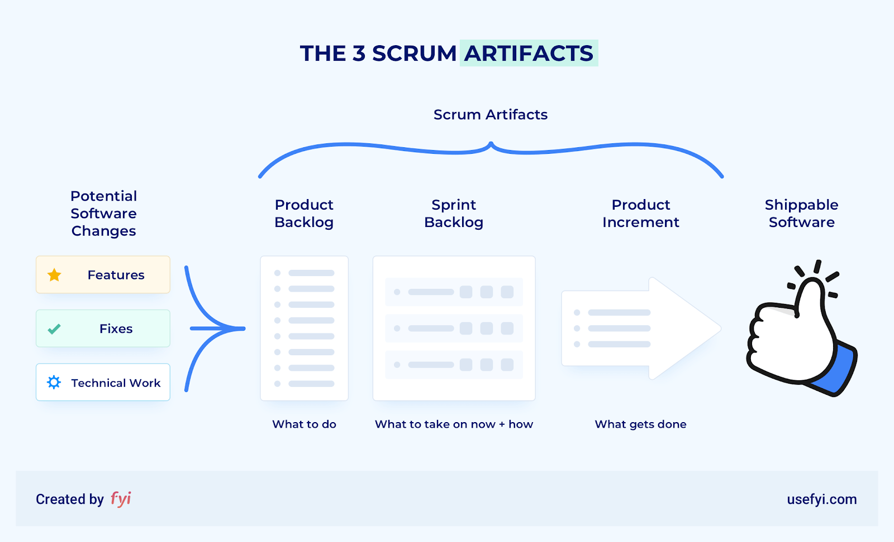

Slide 10
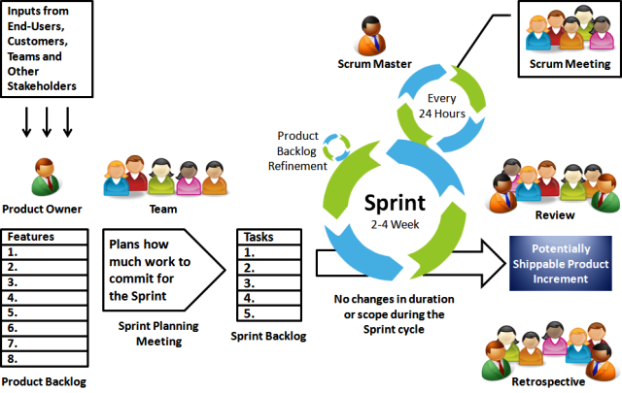
Scrum Process

Slide 11
Uses of scrum
Scrum can help teams complete project deliverables quickly and efficiently
Scrum ensures effective use of time and money
Large projects are divided into easily manageable sprints
Developments are coded and tested during the sprint review
Works well for fast-moving development projects
The team gets clear visibility through scrum meetings
Scrum, being agile, adopts feedback from customers and stakeholders
Short sprints enable changes based on feedback a lot more easily
The individual effort of each team member is visible during daily scrum meetings

Slide 12
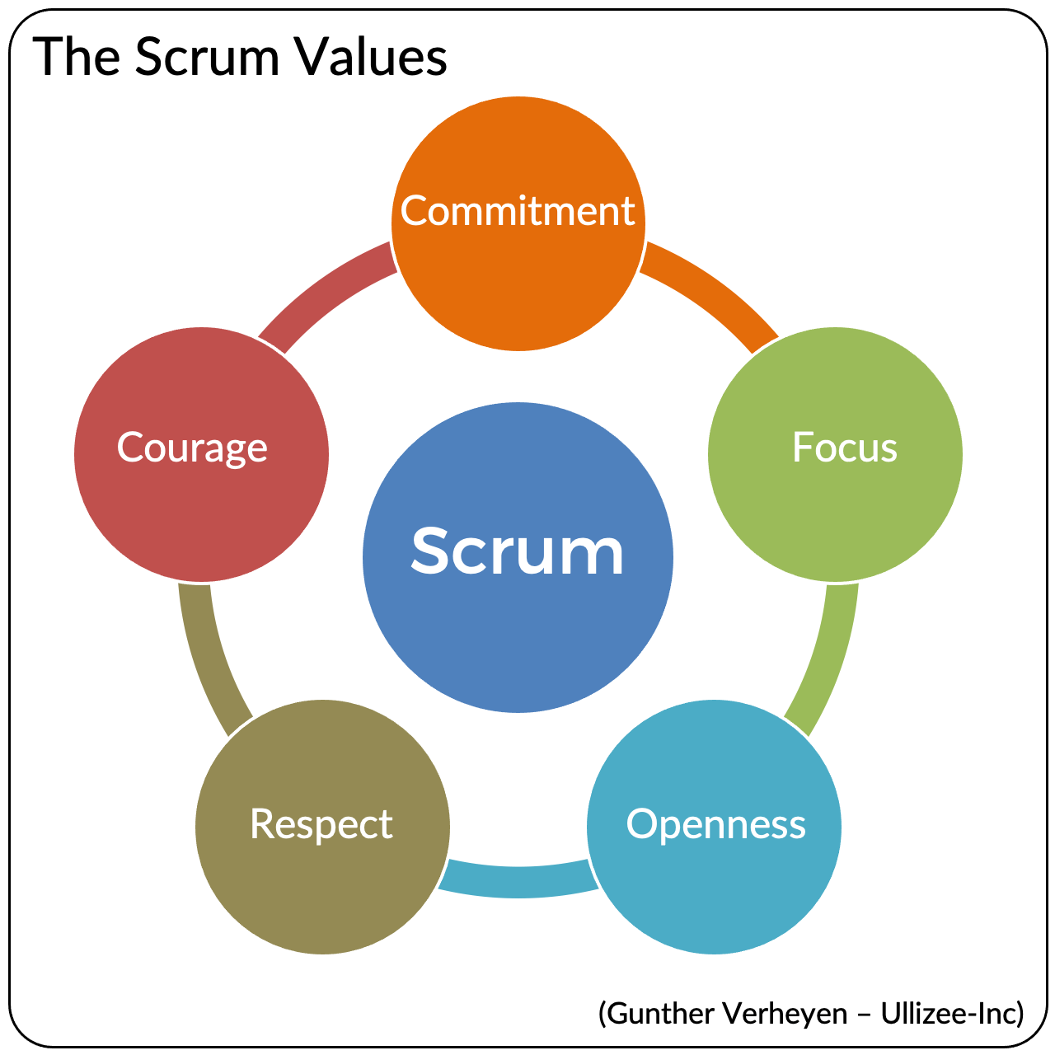

Slide 13
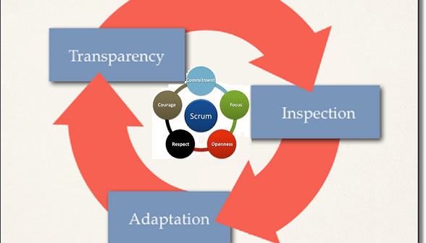
Scrum Theory

Slide 14
Kanban
Kanban is a popular framework used to implement agile and DevOps software development. It requires real-time communication of capacity and full transparency of work. Work items are represented visually on a kanban board, allowing team members to see the state of every piece of work at any time.

Slide 15
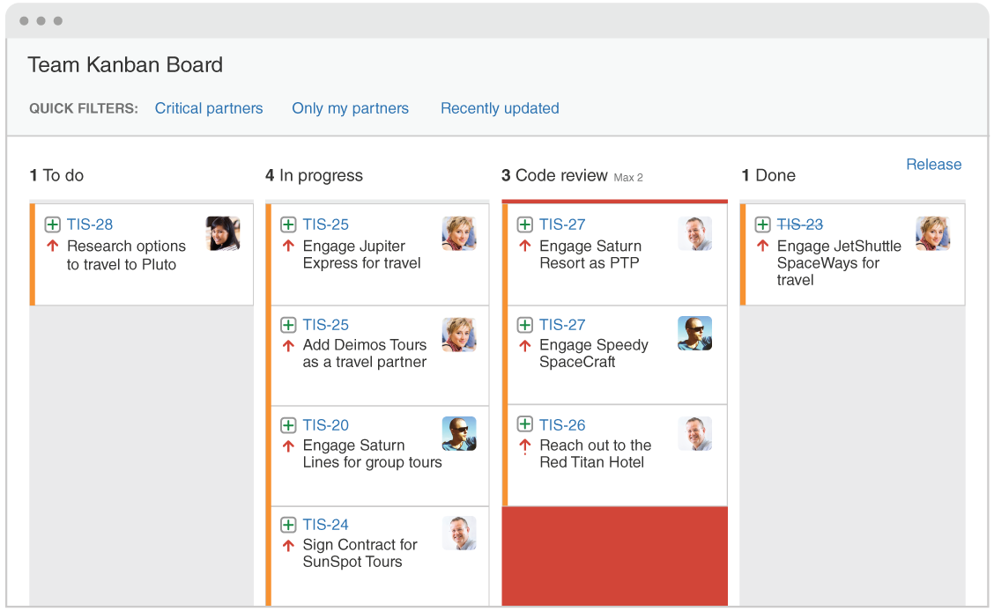

Slide 16
Scrum Vs Kanban
 | Scrum | Kanban
Origin | Software development | Lean manufacturing
Ideology | Learn through experiences, self-organize and prioritize, and reflect on wins and losses to continuously improve. | Use visuals to improve work-in-progress
Cadence | Regular, fixed-length sprints (i.e. two weeks) | Continuous flow
Practices | Sprint planning, sprint, daily scrum, sprint review, sprint retrospective | Visualize the flow of work, limit work-in-progress, manage flow, incorporate feedback loops
Roles | Product owner, scrum master, development team | No required roles

Slide 17
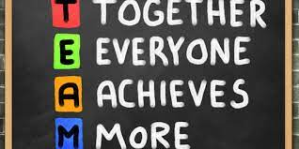
Teamwork
Teamwork is the collaborative effort of a group to achieve a common goal or to complete a task in the most effective and efficient way.

Slide 18
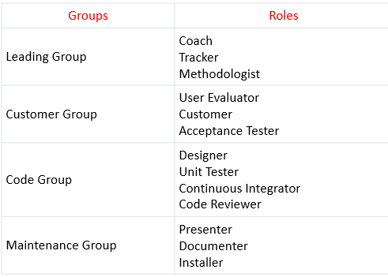
Role Scheme

Slide 19
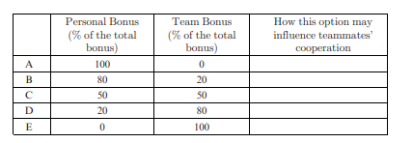
Dilemmas in Teamwork
How to allocate incentives, rewards, and bonuses among team member?

Slide 20
Teamwork in Learning Environments
Assign Roles to Team Members.
Role Activities :
Role Assignment Activities
Role Maintenance Activities
Role Improvement Activity

Slide 21
UNIT-2
Agile estimation techniques, Customers And Users, Time

Slide 22
Agile estimation techniques
T-Shirt Sizing
Sprint Poker
Three-Point Method
Affinity Estimation
Relative Mass Evaluation
Dot voting
Maximum allowable size (MAS)
Big, Uncertain, Small.

Slide 23
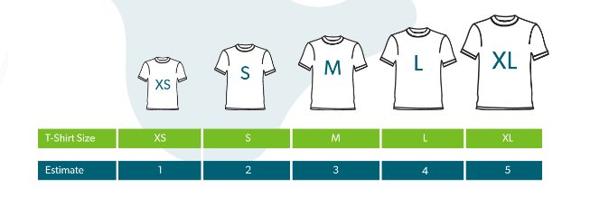
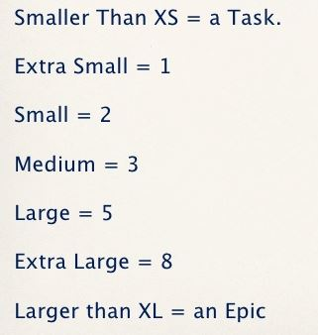
T-Shirt Sizing

Slide 24
T-Shirt Sizing Procedure
Product Owner will explain the story to be estimated and the development team will ask questions if they have any issues
Each developer gives each story, a t-shirt size.
All in members in the development team will raise their cards simultaneously.
The development team will discuss the differences.
The product owner explains the story further or clarifies misunderstanding if any.
The team will Go back to Step 2-Step4 until all are agree with one size.
Complete or place the stories in size buckets.
Estimate the time to complete all stories in S, M, L, XL buckets.

Slide 25
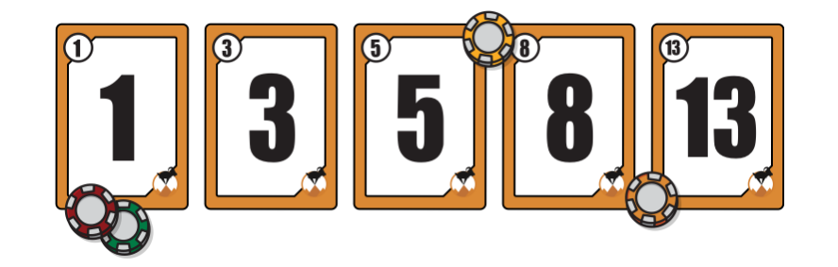
Sprint Poker
The product owner or customer reads an agile user story or describes a feature to the estimators.
Each estimator is holding a deck of Planning Poker cards with values like 0, 1, 2, 3, 5, 8, 13, 20, 40 and 100.
The estimators discuss the feature, asking questions of the product owner as needed. When the feature has been fully discussed, each estimator privately selects one card to represent his or her estimate. All cards are then revealed at the same time.
If all estimators selected the same value, that becomes the estimate. If not, the estimators discuss their estimates. The high and low estimators should especially share their reasons. After further discussion, each estimator reselects an estimate card, and all cards are again revealed at the same time.
The poker planning process is repeated until consensus is achieved or until the estimators decide that agile estimating and planning of a particular item needs to be deferred until additional information can be acquired.

Slide 26
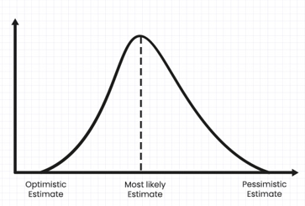
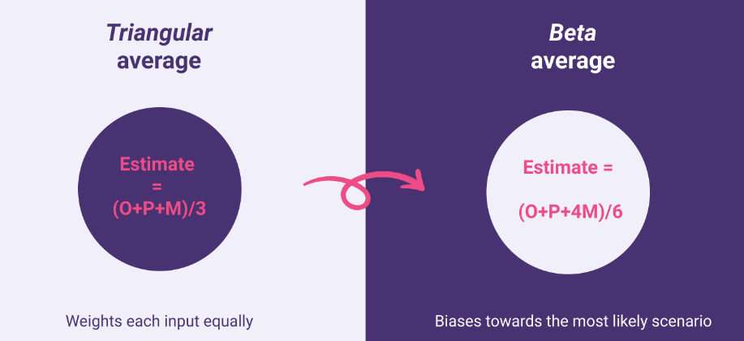
Three-Point Method
Three-point Estimation looks at three values −
the most optimistic estimate (O),
a most likely estimate (M), and
a pessimistic estimate (least likely estimate (L)).

Slide 27
Affinity Estimation
Three steps of Affinity Estimation are:
Silent Relative Sizing
Editing the Wall
Placing items in correct bucket

Slide 28
Affinity Estimation Procedure
Step 1: Silent Relative Sizing
First a horizontal scale is chosen. One end of the scale is marked with “Smaller” and the other end is marked with “Larger”
The product owner provides the user stories to the team.
Each participant estimates their story solely without any discussion with other participants and after estimation, places it at the correct location on the scale, anywhere between “Smaller” and “Larger”.
Step 2: Editing the Wall
Once each story is placed on the scale team members edit the relative sizes on the wall. For this team discussed about the story with each other about its design, implementation or any challenges. Team gets all the doubts clarified from Product Owner as well.
Based on the understanding made during discussion, team re-arranges its story on the scale if required.
Step 3: Placing items in correct bucket
The scale “Smaller” to “Larger” is divided and marked appropriately with the markers of XS, S, M, L, and XL if we use t-shirt sizing technique or with 0, 1, 2, 3, 5, 8, 13, and so on, if we use Fibonacci series of planning poker estimating technique.
Team member now places their stories, which were on scale “Smaller” to “Larger”, to appropriate bucket of the converted scale.

Slide 29
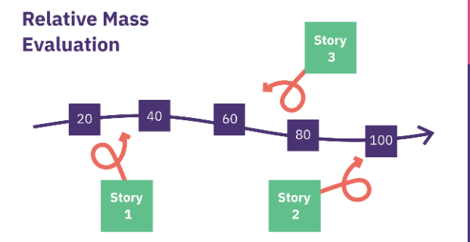
Relative Mass Evaluation
Write up a card for each story.
Then set up a large table so the stories can be moved around easily relative to each other.
Pick any story to start, then get the team to estimate whether they think that it is relatively large, medium, or small.
If it’s a large story, place it at one end of the table. If it’s a small story, it goes at the other end of the table. A medium story goes in the middle. Now select the next story and ask the team to estimate if it’s more or less effort than the story that you just put down. Position the story card on the table relative to the previous card, and go to the next card.

Slide 30
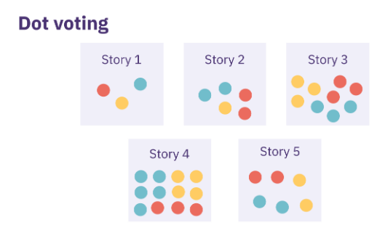
Dot Voting
All user stories are put on a wall, virtual or real by the Product Owner.
Every team member is given 4-5 votes; these can be small round sticky notes.
Every team member is asked to give their votes on the stories they think are bigger.
Team member puts/pastes the round red sticky notes on the stories they think are big in size.
Every team member performs this process until their all 4-5 votes are exhausted/used. At the end of this process, the story with higher votes is termed as biggest and that with low number of votes are smallest.
Product owner then orders the story from higher votes to lower votes.
One person can vote more than once for one story.
Same technique is used to decide priority as well. More votes means higher priority item.

Slide 31
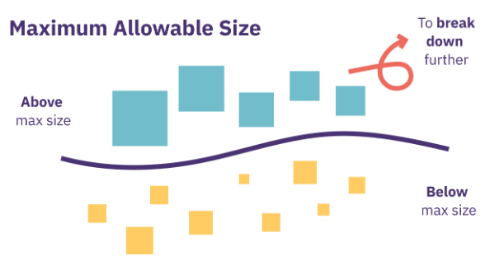
Maximum allowable size (MAS)
Set your estimation scale. In this case, it might be worth using a scale according to the number of hours something will take, so you have a concrete idea of the maximum amount of time you want your team to spend on a given piece of work. This will make your filtration more actionable.
As a general rule, user stories probably shouldn’t take more than 16 hours of work, otherwise they can become unwieldy. So you might want to take 16 hours as your maximum allowable size. If you don’t need the same level of precision, use the good old t-shirt sizes to guide you.
Now the task is to go through all the stories in your backlog and filter out the ones the team think are higher than 16 hours by voting on them.
You can then take those items and discuss how to break them down so they fit below the maximum allowable size.

Slide 32
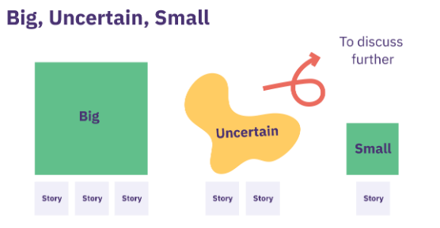
Big, Uncertain, Small
The ‘Big/Uncertain/Small’ agile estimation method is similar to the bucket system. It involves placing the estimated items in one of the three categories. Teams discuss the items and then a ‘divide-and-conquer’ technique used to estimate the rest of the items. The items left are distributed among team members and can be quickly estimated in parallel.

Slide 33
Customer and User
Who is a customer?
Who is a User?
Can customer be a user?
Can a user be a customer?
Who can be a user?
Who can be a customer?

Slide 34
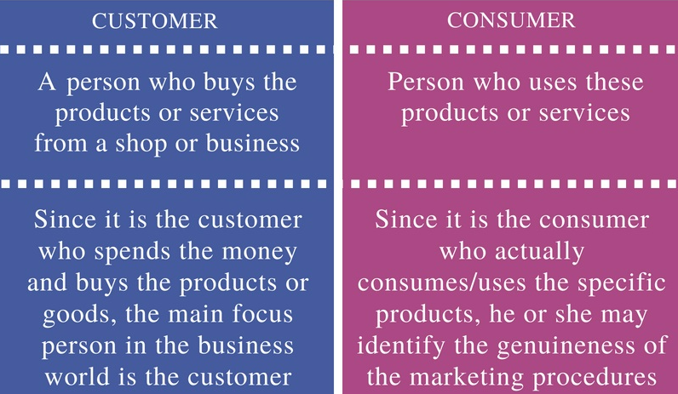
Customer Vs User

